Slide 1


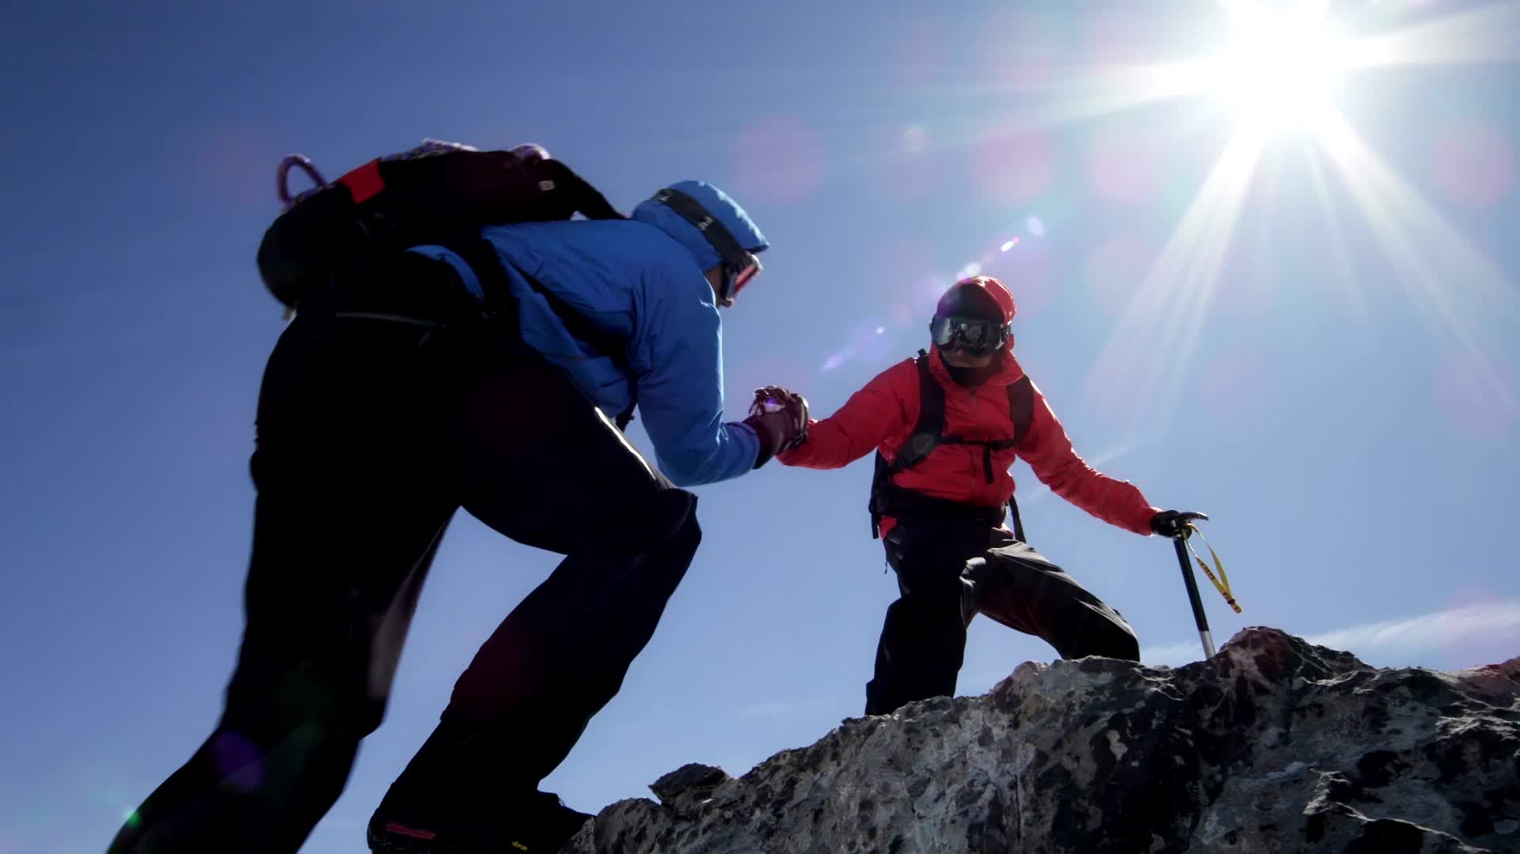
VR Training for First Aid Skills
COMP-8490 Virtual Reality – Project Presentation
Lei Jiang

Slide 2

Topic & Motivation
VR training for basic first aid skills (focus on adult CPR)
Help beginners practice in a safe, repeatable, immersive way
Bridge the gap between one short course and real emergencies

Slide 3
Pain Points of Traditional Training
Short courses, limited hands-on practice – people forget steps
1
Dependence on instructors, manikins, and classroom time
2
Learners feel unsure or nervous in real emergency situations
3

Slide 4
Market Research – Existing VR Products
VR CPR / first-aid apps: scenario-based training with basic scoring
Professional trauma / nursing VR: complex, team-based hospital scenarios
Show VR is already used, but often for one specific skill only

Slide 5
My System – Strengths
Beginner-friendly: simple interactions & step-by-step guidance
Simple to deploy and low operating cost
Clear feedback: which steps were done, which were missed

Slide 6
My System – Limitations
Prototype-level system with only one or two scenarios
Simple interaction & evaluation, not fully medically precise
Requires VR hardware, which may limit access

Slide 7

Future Plan – Technical
Add more first-aid scenarios (bleeding, choking, burns, etc.)
Improve interaction quality and feedback detail
Explore WebXR / web-based VR for easier access
Establish a complete data analysis

Slide 8
Future Plan – Research & Deployment
Run small user studies (usability & confidence)
Compare VR practice with traditional first-aid teaching
Work with first-aid instructors and integrate into real courses

Slide 9
Thank you

